Slide 1

Direction and Compass
Lesson 11

Slide 2
What the Lesson Will Cover
Be aware of north and true north
Have an understanding of how a Magnetometer works
Calibrate the compass on the micro:bit
Program a real time compass
Notes:
Introduce the lesson and what it will cover, Learners could discuss or ask question about what the lesson might involve.

Slide 3
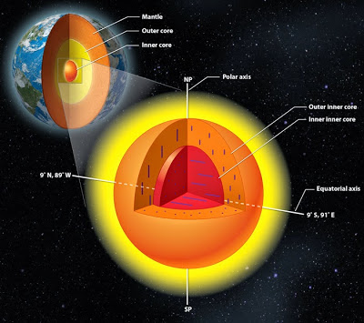
North
This Photo by Unknown Author is licensed under CC BY-SA-NC
The Earth has two norths, the first is true north which located at the North Pole and runs straight down to the South Pole
Magnetic north is constantly shifting and is caused by the iron core and molten liquid metal core in the centre of the Earth
As the Earth rotates and the metal moves it creates currents and these produce a magnetic field.
Notes:
Explain the difference between North and True North

Slide 4
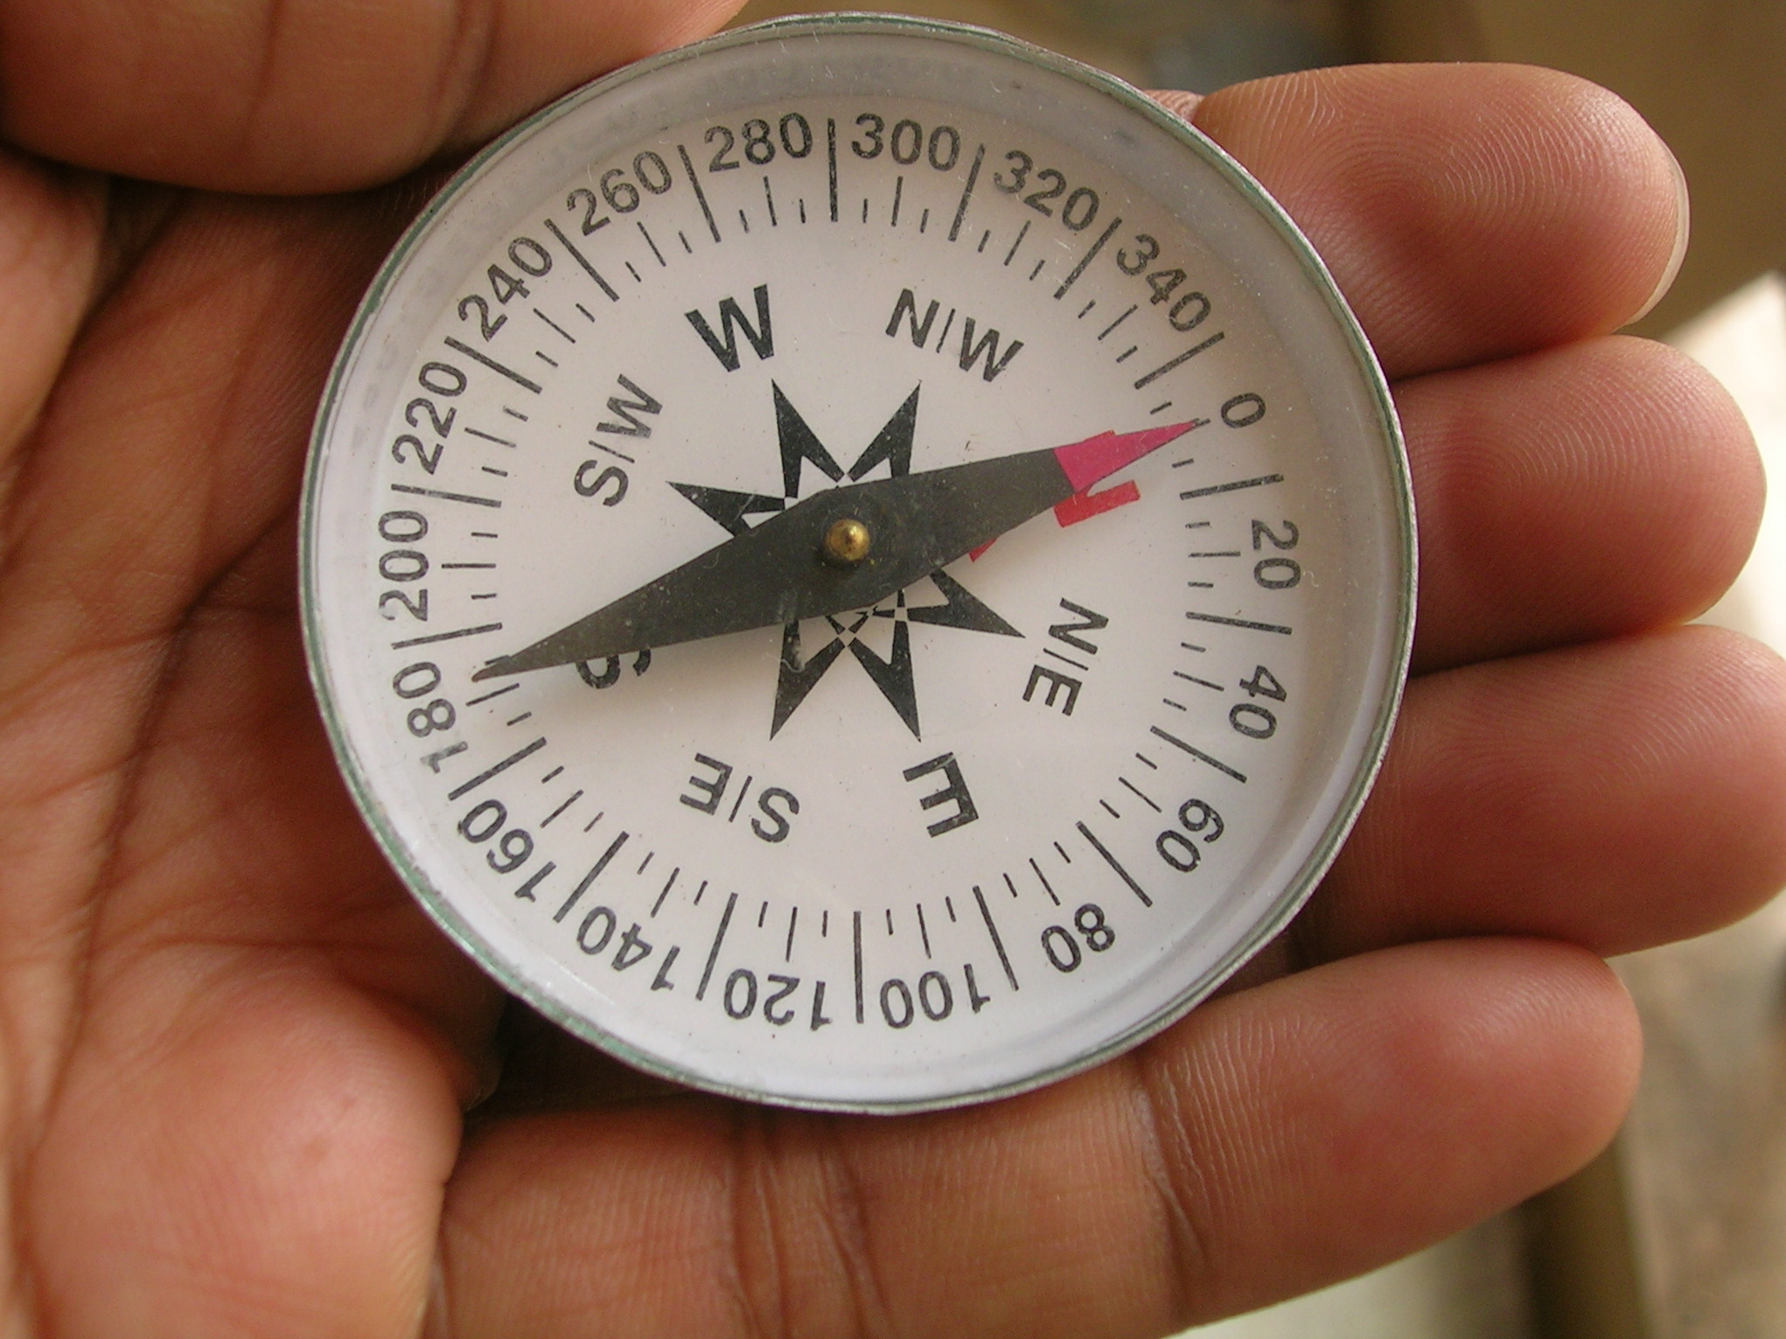
The Compass
A compass is an instrument which shows the direction of magnetic north
This direction is measured in degrees and is called a bearing – from this your location can be calculated
A compass has four cardinal points: north, east, south and west
The magnetised metal indicator in a compass is free to move and always points towards magnetic north
This Photo by Unknown Author is licensed under CC BY-SA
Notes:
Explain how a Compass works

Slide 5
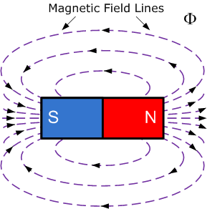
The Magnetometer
The magnetometer uses a sensor known as solid-state Hall effect sensor
Electricity is a flow of electrons and magnetic fields affect electrons
The sensors are affected by the electrical currents that magnetic field produces
The field causes the electrons in the sensor to move to a particular position
The ‘position’ is used to measure the magnetic field
Notes:
Explain how a Magnetometer works

Slide 6
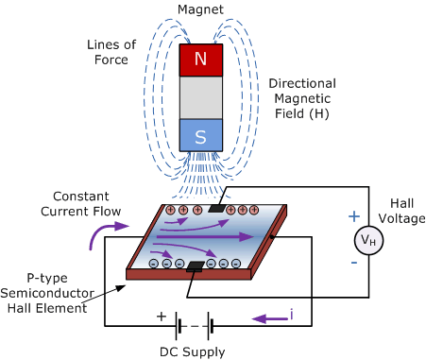
The Magnetometer
The position of the electrons are then measured and this is used to calculate the magnetic field.
When the magnetic field is removed the electrons move back, this means the direction of the magnetic field can be calculated.
Images from https://www.electronics-tutorials.ws/electromagnetism/hall-effect.html
Notes:
Explain how a Magnetometer works

Slide 7
Calibrating the Compass
Before you can use the magnetometer as a compass you have to calibrate it
This takes a number of readings and set the correct ‘north’ position
Use the program below to calibrate
from microbit import *
compass.calibrate()
Download to your micro:bit, then rotate it to turn until all the LEDs. You will see a smiley face when complete
Notes:
Get Learners to try the calibration program or demonstrate it to them.

Slide 8
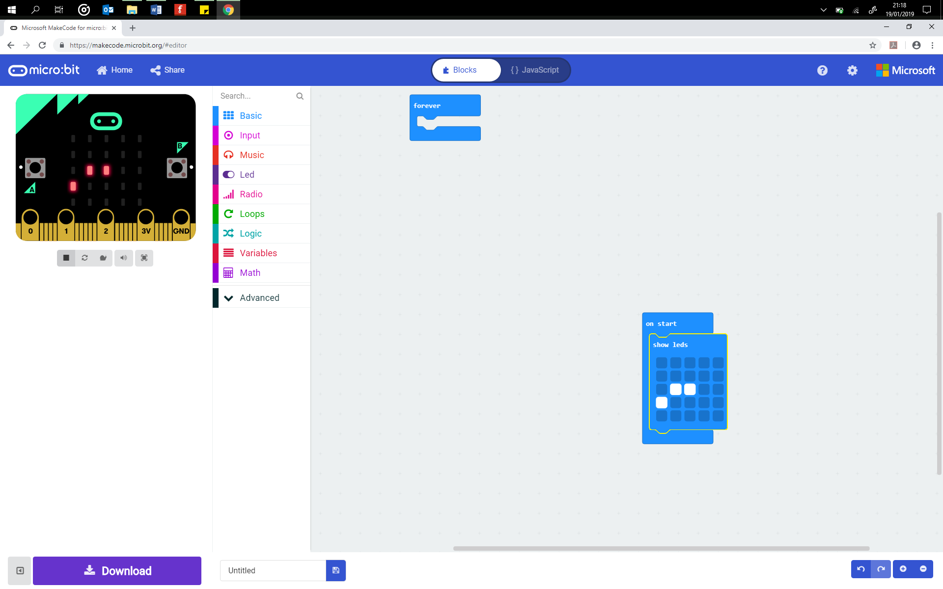
Creating a Compass
Use the activity sheet to build a real time compass.
The compass has 12 positions which are used to indicate true north
Ensure that you keep the micro:bit away from metal and other magnets as they will interfere with the values and return false readings

